Slide 1
Fast, Small, Accurate(-ish)
A 4-Bit LLM Tour with Qwen3-32B
David Pickett
Purple Maiʻa Foundation • November 2025

Slide 2

About Me
Carnegie Mellon, BS Comp Sci
Ex-Microsoft
Software Dev 20+ years
CTO of Purple Maiʻa

Slide 3

About Purple Maiʻa
Notes:
https://purplemaia.org
Oahu-based, NH-led, tech education nonprofit
We are on a mission to educate and empower the next generation of culturally grounded, community serving technology makers and problem solvers.
Various partnerships and initiatives involved in making software, training students and apprentices, and creating/using AI tools

Slide 4





What Are Open-Weights LLMs?
Notes:
Today we’ll be talking about quantization options, but really it is in the context of open-weights models that you can run somewhere in the cloud or on your own hardware (you don’t know wha
Deepseek (crazy to think it just launched in Jan 2025)
Alibaba’s Qwen models
Mistral out of France
Meta’s Llama models
OpenAI’s OSS models
I got into open-source LLMs around the release of LMSys’s Vicuna finetune of Llama 14b in Mar/Apr 2023
Today weʻre talking about Qwen3-32B, a release from earlier this year that is well supported across a bunch of hardware/software now
It is also a hybrid-reasoning model and is a pretty good model that you could run at home on a gaming PC if you wanted to

Slide 5
What is Quantization?
FP16
8-bit
4-bit
64 GB
32 GB
~16 GB
Full precision
Minor loss, 2x speed
Some loss, 4x speed
The Critical Question
Which 4-bit format to choose?
9+ Formats
20% Accuracy Range
Major Throughput Differences
AWQ, NVFP4, ExL3, GGUF...
75-96% of baseline
Platform & format dependent
Notes:
Quantization is essentially lossy compression of the LLM - trade some precision/accuracy to gain speed and lower memory use
Lower memory use means you can do more with less hardware (whether that is bigger models, more concurrent users/tasks, or both)
The memory size numbers Iʻve got on the screen are specific examples for a model with 32B parameters

Slide 6
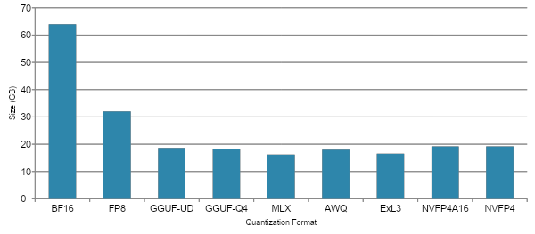
Memory Footprint Comparison
Notes:
How big of a difference are we talking about?
Rule of thumb is that a model in 8bit takes up the number of gigs as it has billions of params - 32B means 8bit is 32gigs
It is important to know what size model you are working with because ideally you want to fit the model completely in fast memory (whether that is vram or unified ram)

Slide 7
Test Setup and Methodology
Formats Tested
Benchmarks
NVIDIA: AWQ, NVFP4, FP8, Exl3, GGUF variants
Apple: MLX, DWQ, MXFP4
Accuracy
LiveBench, Aider Polyglot
Speed
Hardware
vLLM benchmark-serve, llmperf; single & concurrent (10-50)
NVIDIA RTX 6000 Pro Blackwell
Apple M3 Ultra
Models
Qwen3-32B, Qwen3-8B (for a few comparisons on Apple)
Notes:
I wanted to do this experiment particularly because of some new format options that people are buzzing about this year: NVFP4, MXFP4, and DWQ-MLX
I use LiveBench as a reference to understand how models perform across a variety of capabilities and you can run an older version of the tool yourself
Aider Polyglot is a pretty difficult coding benchmark that has emerged as a good way to measure not only coding but instruction following and applying changes
I tested on a single Nvidia GPU for most of the runs, and a single Mac Studio for the Apple-only measurements
I did run a few comparisons between quant formats using a smaller model (Qwen3-8B) when I had to because the benchmarking on Apple could be very slow at times for the 32B model

Slide 8
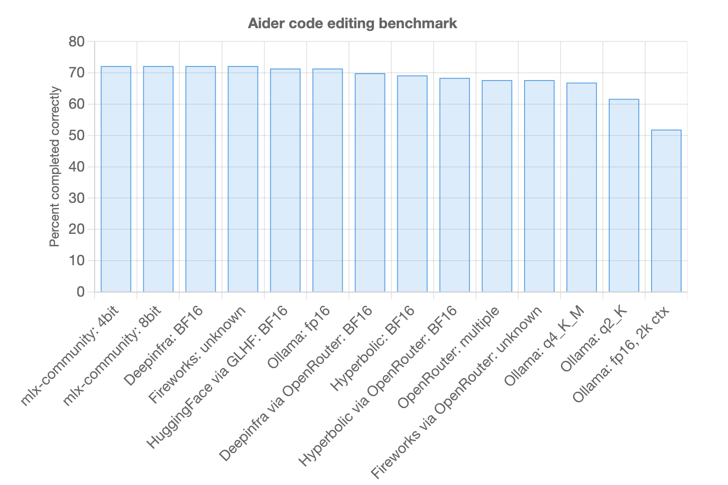
Inspiration
Details matter with open source models (Aider blog, Nov 2024)
Notes:
Talk about why I got into understanding configuration and settings for open-source models back in 2024
Various providers serve the same model differently, get different results on the same benchmark (also see Qwen3 update May 2025)

Slide 9
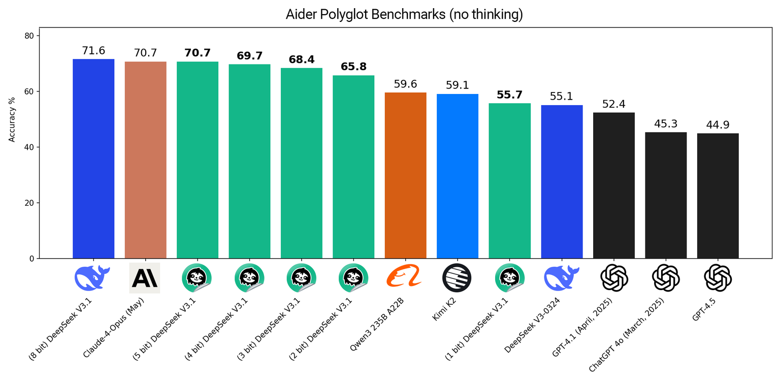
Inspiration (cont)
Unsloth Dynamic GGUFs on Aider Polyglot (unsloth, Sep 2025)
Notes:
Lower quants of bigger models can perform better than bigger quants of small models

Slide 10
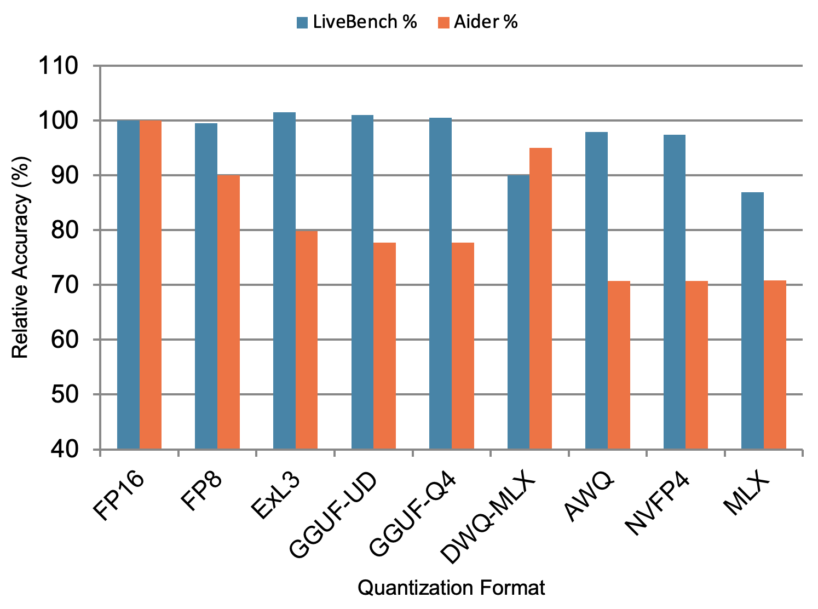
Accuracy Comparison: LiveBench + Aider
Compared to 16-bit
FP8: 96.6% combined
Exl3: 96.1%
GGUF-UD: 94.2%
GGUF-KM: 93.7%
DWQ-MLX: 92.5%
AWQ: 89.8%
NVFP4: 89.4%
MLX: 78.9%
Notes:
Note these accuracy scores are percentage-based where the full-sized 16 bit model is considered 100%
On Apple, MLX score is normally be expected to match/exceed AWQ - but DWQ is easy to make an increasing accuracy a lot without a speed penalty
It does not mean that the unquantized model scored 100% on the benchmark - just a way of showing the combined Aider and Livebench results on a common axis

Slide 11
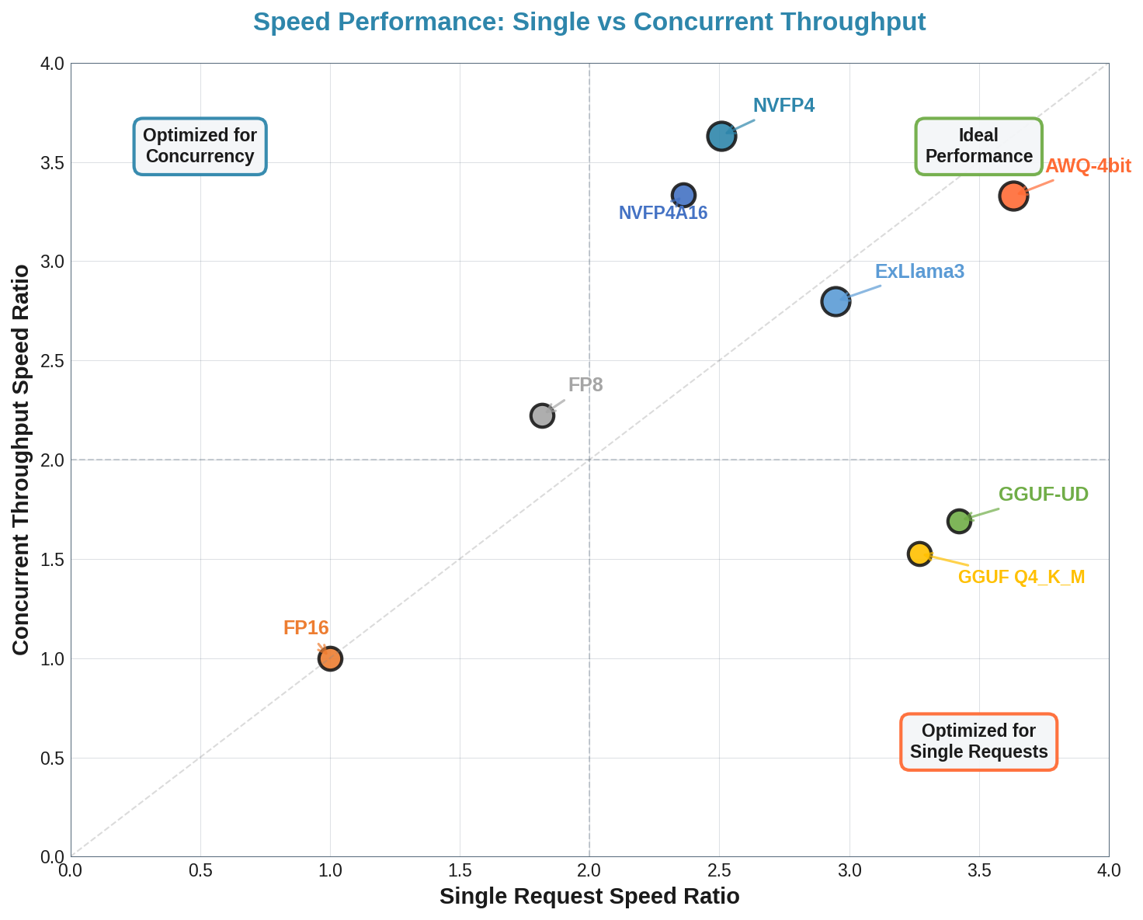
Speed: Single vs Concurrent Throughput
Notes:
Previous slides showed us accuracy, lets talk about speeds
Difference between serving one person or request at a time and being able to serve concurrent users/tasks
Note that we don’t have MLX on this slide because MLX currently does not support concurrent users/tasks so for speed we are setting aside Apple hardware
This graphic shows calculated ratio compared to FP16 as “1x” speed with the other quant formats showing the amount of speedup in comparison

Slide 12
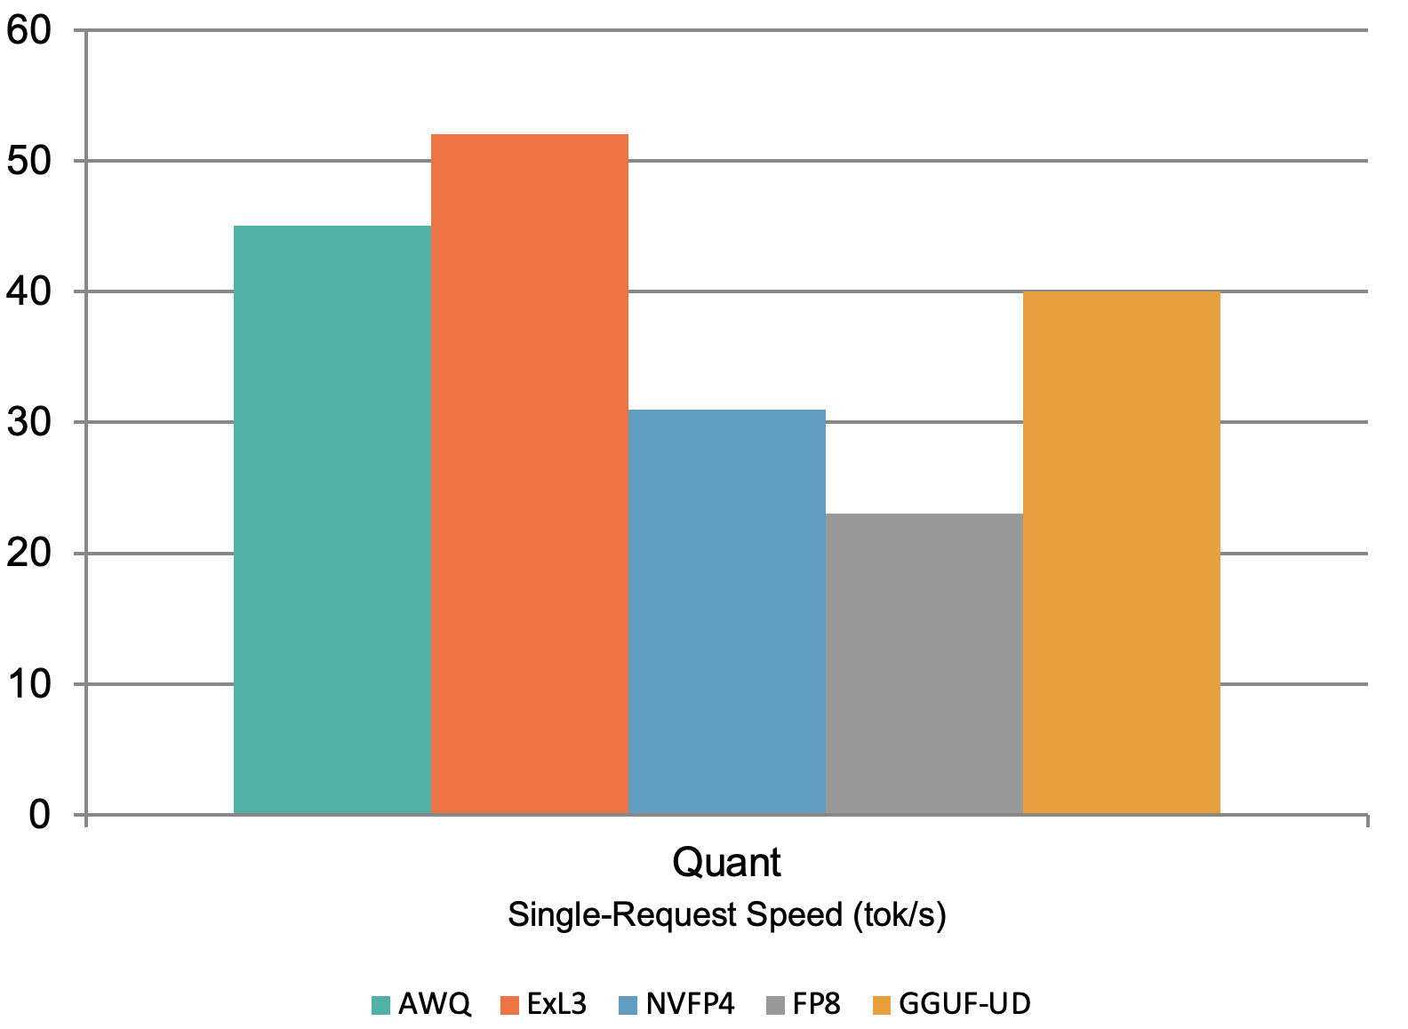
Efficiency: Speed or Accuracy
Optimal Formats
AWQ-4bit
90% accuracy
45 tok/s single, and 267 tok/s concurrent
Best for: Production
Exl3-4bpw
96% accuracy
52 tok/s single, and 139 tok/s concurrent
Best for: Single-user
FP8
96.6% accuracy
2x memory usage, so about half the speed
Verdict: Skip it
Notes:
AWQ-4bit really is a sweet spot right now if you have the hardware for it (e.g. it will not run on Apple)
Exl3 is great technology for the accuracy
GGUF is doing really well for ease of use, cross-platform flexibility, good accuracy, and decent performance
NVFP4 shows promise in the concurrency space - but probably needs a more optimization at the software level to really shine (and requires Blackwell or newer hardware)

Slide 13
Takeaways
4-bit ≠ 4-bit
21% accuracy spread proves format choice is critical
AWQ wins production (for now)
90% accuracy with excellent throughput scaling - NVFP4 shows promise to get better
On Apple, mostly use GGUF (for now)
DWQ-MLX is a good option for single user speed/accuracy, but GGUF has a better balance of accuracy/throughput/options

Slide 14
Thank You!
Questions?
Data Available:
https://github.com/PurpleMaia/nov-2025-quant-data
David Pickett: david@purplemaia.org

